Slide 1
Attention Is All You Need
Ashish Vaswani*, Noam Shazeer*, Niki Parmar*, Jakob Uszkoreit*, Llion Jones*, Aidan N. Gomez*†, Łukasz Kaiser*, Illia Polosukhin*‡
Google Brain, Google Research, University of Toronto

Slide 2
Introduction
Problem: Existing sequence transduction models (RNNs, CNNs) are inherently sequential, limiting parallelization and training speed.
Objectives: Propose a new architecture, the Transformer, based solely on attention mechanisms.
Motivation: Achieve superior translation quality with increased parallelization and faster training.

Slide 3
Methods
Methodology: Transformer architecture based entirely on self-attention mechanisms.
Datasets: WMT 2014 English-German and English-French translation tasks, Penn Treebank for English constituency parsing.
Experimental Setup: Trained on multiple GPUs, using Adam optimizer, various regularization techniques (dropout, label smoothing).

Slide 4
Results
Machine Translation: Achieved state-of-the-art BLEU scores on WMT 2014 English-to-German (28.4) and English-to-French (41.8) tasks.
Significant improvement over existing models, including ensembles, with substantially reduced training time.
Table 2: Summarizes BLEU scores and training costs compared to other models.
Table 3: Shows the impact of different architectural choices on performance.
English Constituency Parsing: Achieved competitive results on English constituency parsing, outperforming previous models in both small and large data settings.
Table 4: Presents parsing results compared to other models.

Slide 5
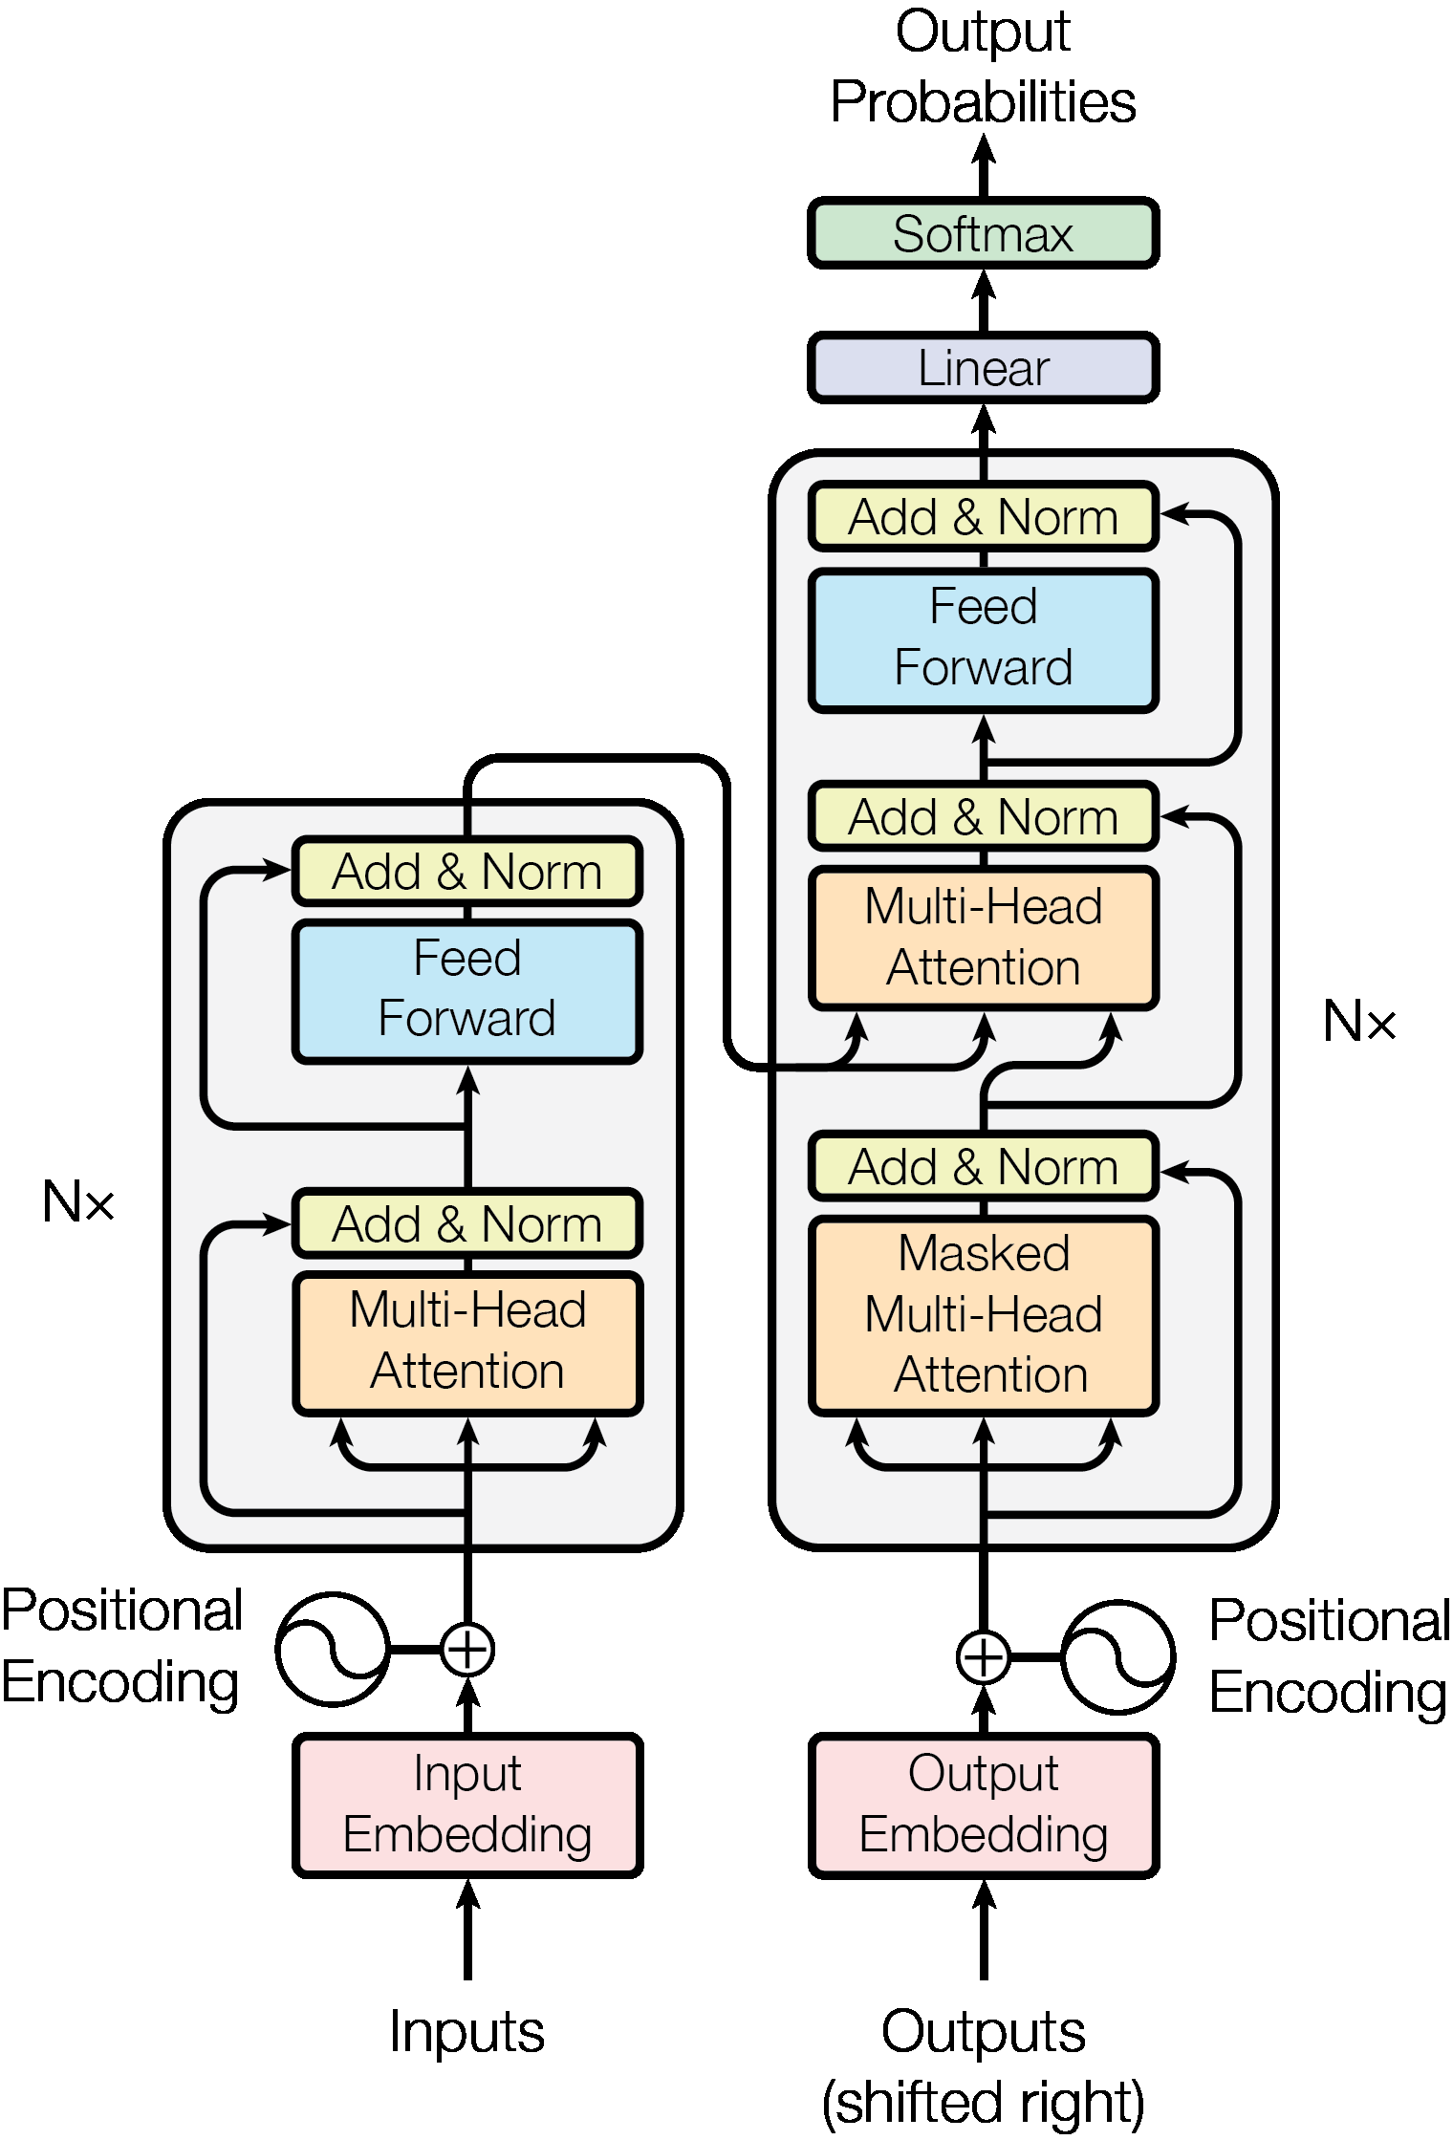
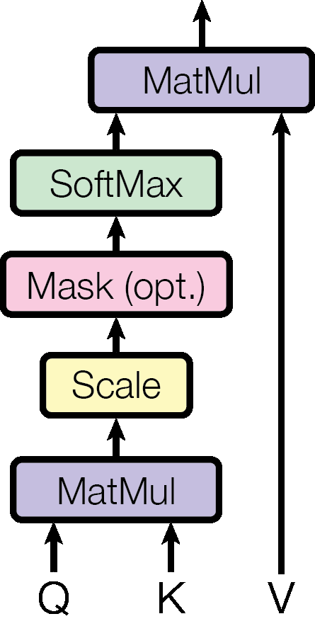
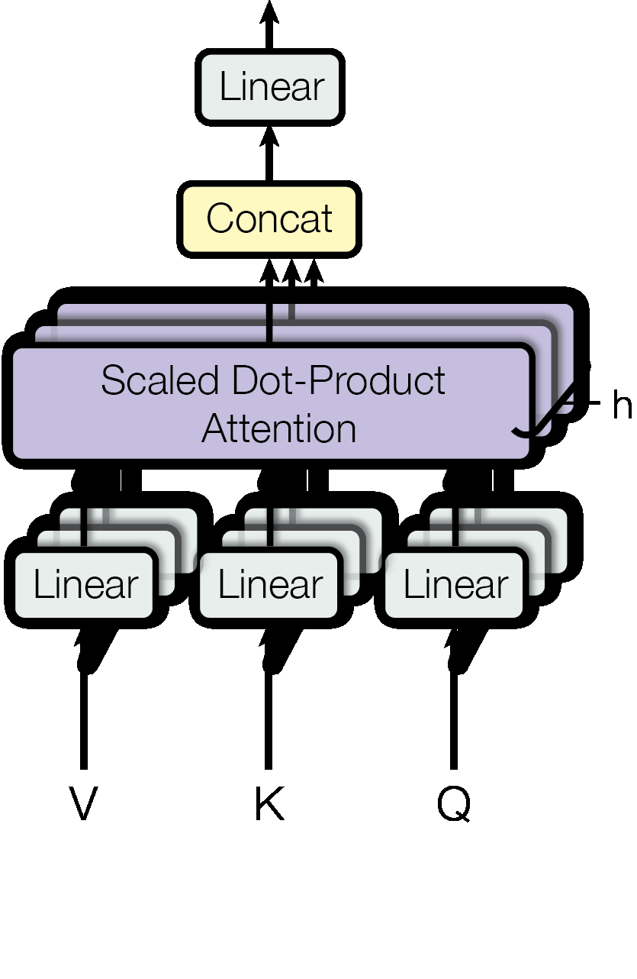
Fig 1
Fig 2
Fig 3

Slide 6
Discussion
Significance: The Transformer's superior performance and efficiency demonstrate the potential of attention-based models for sequence transduction.
Comparison with Prior Work: Outperforms existing RNN and CNN-based models in both translation quality and training speed.
Interpretability: Attention visualizations reveal insights into the model's internal workings, showing attention to syntactic and semantic structures.

Slide 7
Conclusion
Key Takeaways: The Transformer, a novel architecture based solely on attention mechanisms, achieves state-of-the-art results in machine translation and generalizes well to other tasks.
Future Work: Explore applications to other modalities (images, audio, video), investigate local attention mechanisms for efficiency, and improve the sequentiality of generation.

Slide 8
References
[1] Jimmy Lei Ba, Jamie Ryan Kiros, and Geoffrey E Hinton. Layer normalization. arXiv preprint arXiv:1607.06450, 2016.
[2] Dzmitry Bahdanau, Kyunghyun Cho, and Yoshua Bengio. Neural machine translation by jointly learning to align and translate. CoRR, abs/1409.0473, 2014.
... (List remaining references)

